Slide 1

TECHNOLOGY IN LEADERSHIP
This presentation highlights the key takeaways
and skills gained from completing
Presented By
Nusrat Jahan Anka

Slide 2




Course Overview
Lead Academy
Shah Paran
# Founder & CEO of Handy Mama
# Co founder & Treasurer of Wreetu Health & Wellbeing Foundation
# Digital Transformation Leadership
# Innovation Managers
# Start-up Founders
Total 7 Lessons
1 hrs 11 min

Slide 3






Key Topics Covered
Technology in Workplace
Educational Institute, Star-tup, Giant Companies, Hospitals, Travel agencies, Conventional work environment (Ex: Effective Communication, Innovative Solutions, Ensuring smooth user experience)
Relationship between Technology & Leadership
To make fast growth in digital era leaders needs strong bond with technology. Either leaders will adapt technology for fast progress or leaders will be lost over time.
Collaboration Tools & Use cases
Communication & Virtual Conferencing tools - Zoom, Google meet, Microsoft teams (Ex: online class or meeting)
Project Management tools - Trello, Slack (Ex: Office or team work)

Slide 4




Practical Applications
Real-world Applications:
These are some real world applications which are mentioned in these course.
E-Book (Kindle)
E-Commerce Companies (Using Automation)
Remote/Virtual Work (Google Meets, Microsoft teams, Zoom)
Productivity (Google sheet, Accounting software)
Home Service facilities (Foodpanda, Uber, Pathao)
Personal Experience:
Here are some applications which I used for personal purpose.
Online Classes/Meetings (Google Meet)
Virtual Internship (Google Form, Trello)
Organize & analyze information (Google Sheets)
Google Meets
E-Book
Home Service
ChatGPT

Slide 5
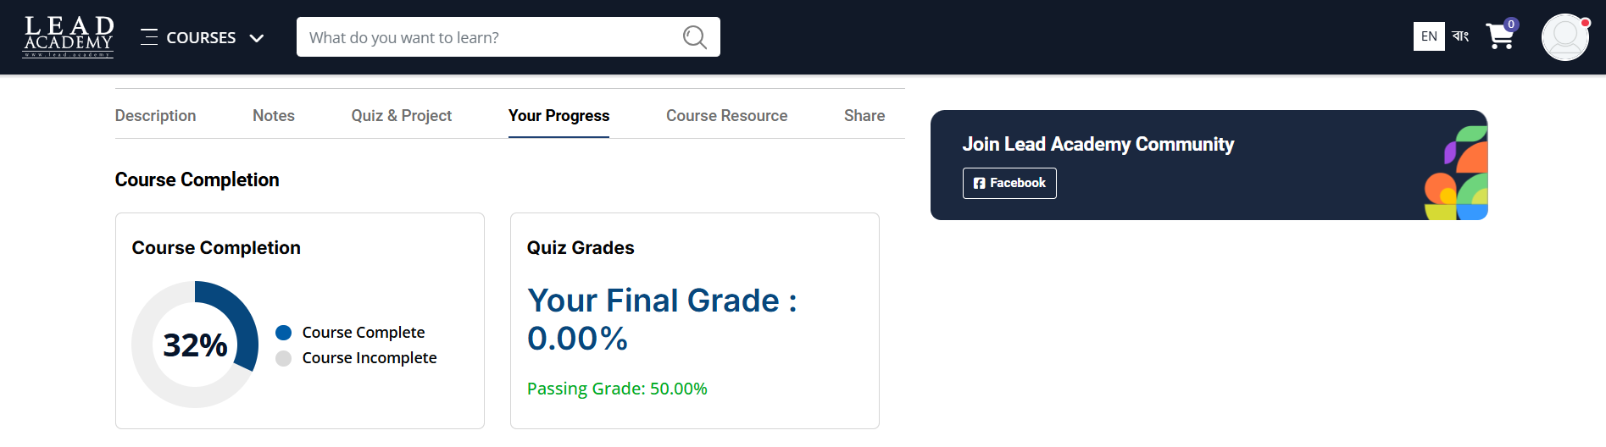
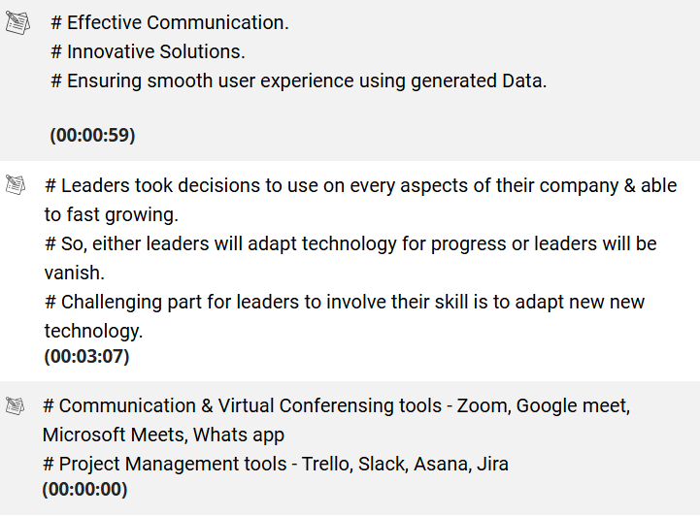
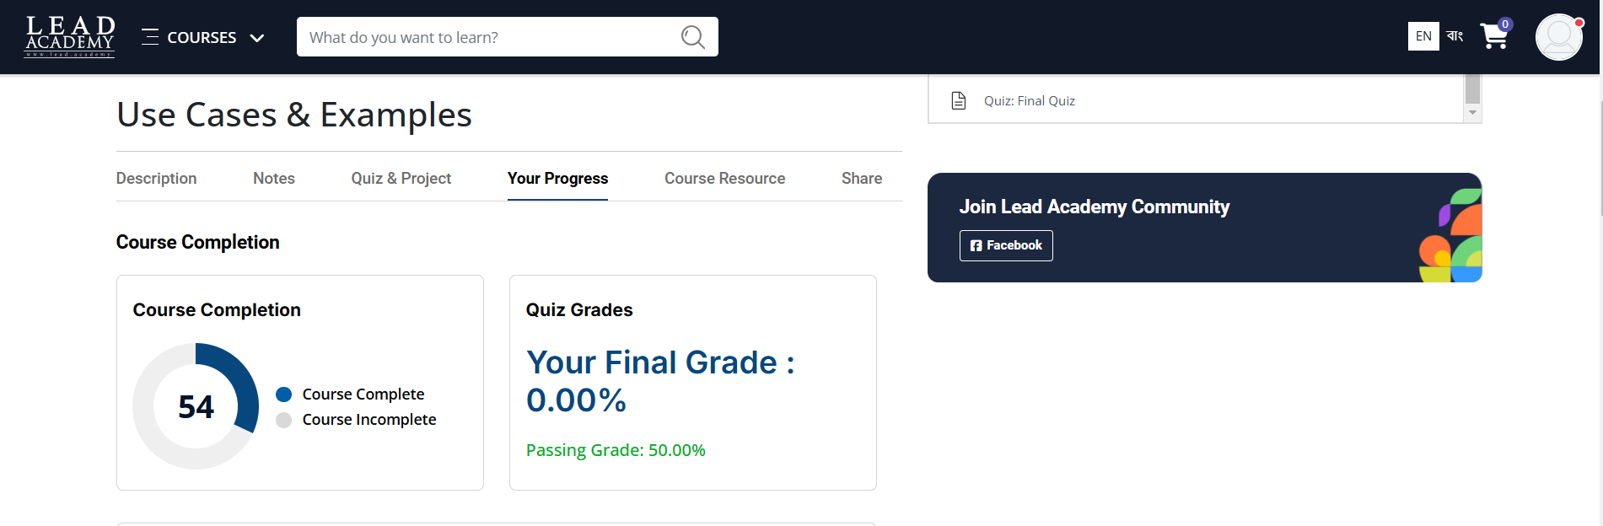
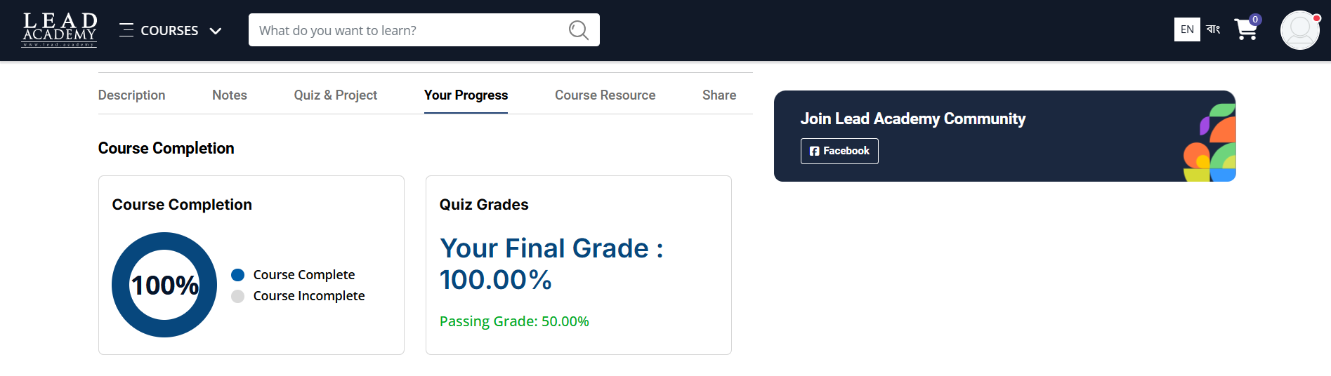
Course Completion Progress
Here, I have presented my progress chart during the course completion. The interesting thing about this course was that I was able to write down important notes on their platform which was quite helpful.

Slide 6
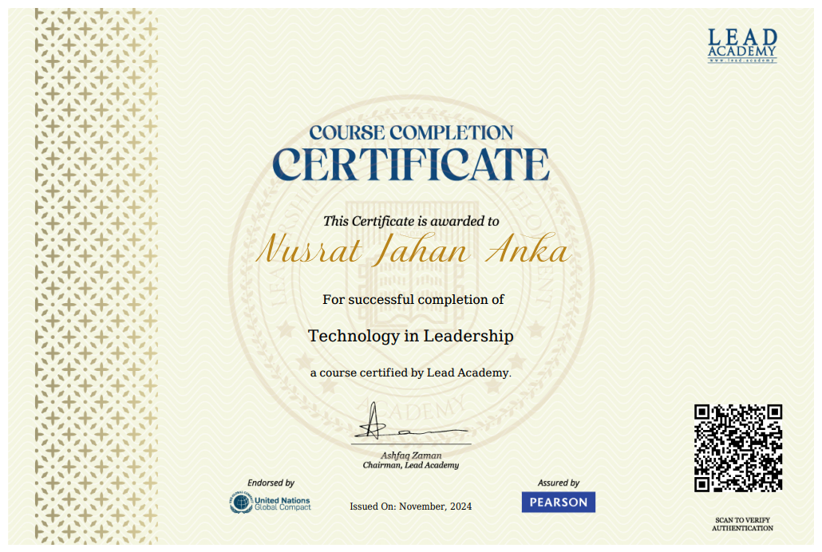
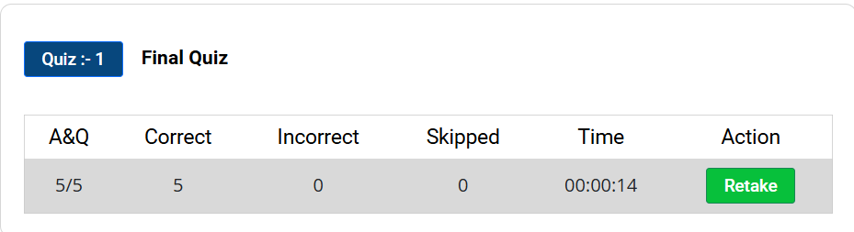
Certifications and Achievements
After completion of all lessons solved the “quiz” section & able to achieve my result with a certificate.

Slide 7
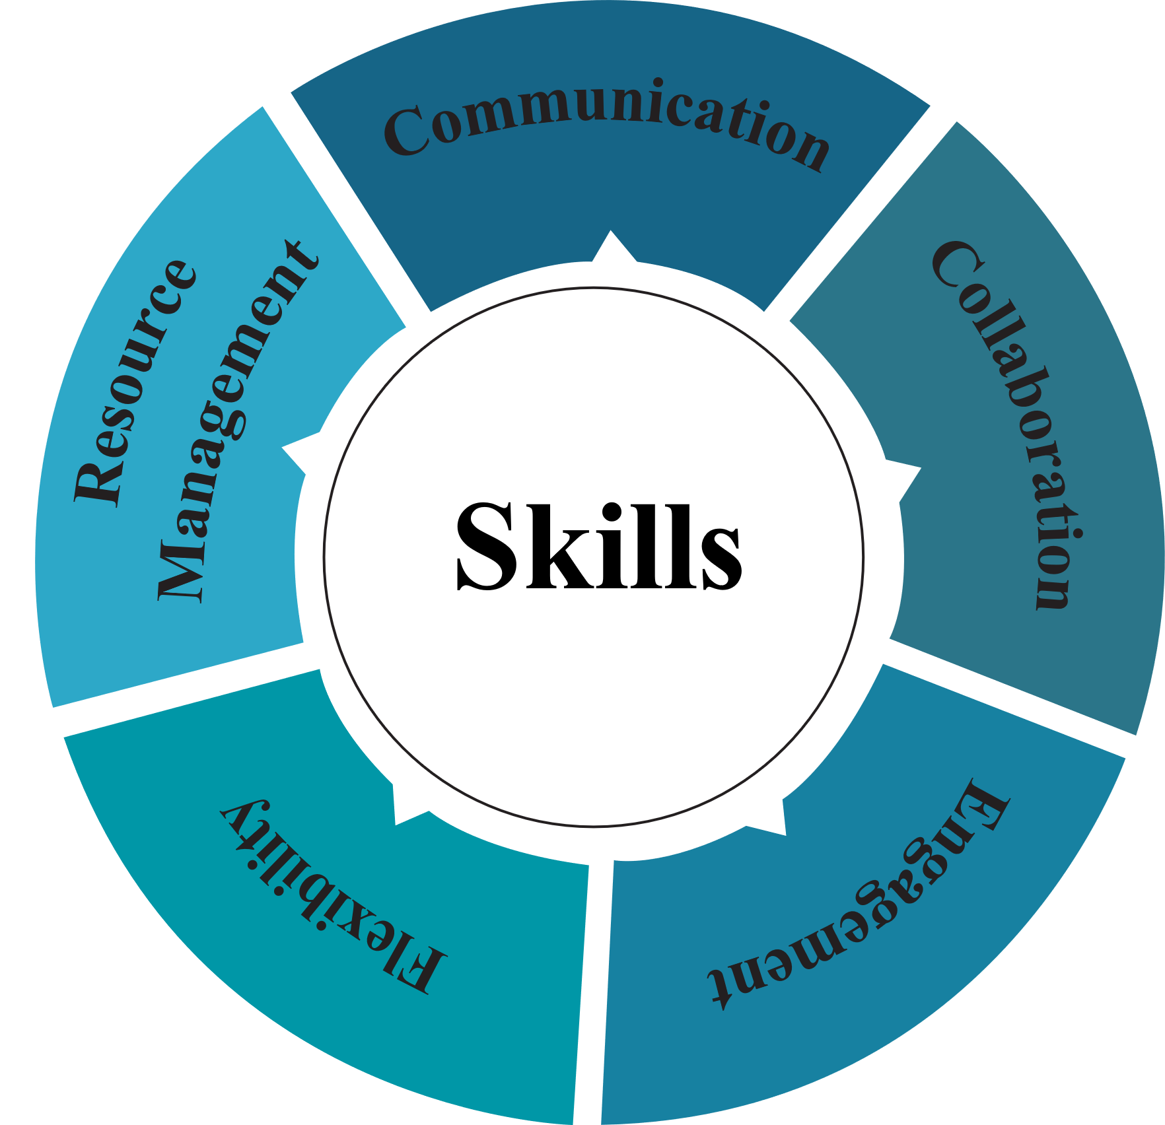
Skills Acquired & Applying Knowledge
Technology can play a significant role in leadership. Here, I am presenting the skills I acquired from this course.
I am planning to apply the skills and knowledge I have gained from this course in my personal or professional life. Such as using communication tools I can contact with International professors for my research. I can use the collaboration & resource management tools for extra curricular activities.

Slide 8
Conclusion
Technology is mainly which reduces our effort and makes us feel comfort in doing our works efficiently.
This course provide an overall aspect of connection between technology & leadership. Through this course I learned the ultimate pathway to lucrative opportunities and impactful leadership in today's rapidly evolving tech landscape. Technology empowers to commandeer the helm of success, guiding organization to new heights and propelling career to lucrative horizons. An upgrade leader guides and motivates followers through technology.
Thank You

